Slide 1


Accelerating innovation in home technology
Ratul Mahajan

Slide 2











Partners in crime
A.J. Brush
Evgeni Filippov
Danny Huang
Jaeyeon Jung
Ratul Mahajan
Ray Matharu
Frank Martinez
Khurshed Mazhar
Amar Phanishayee
Arjmand Samuel
James Scott

Slide 3
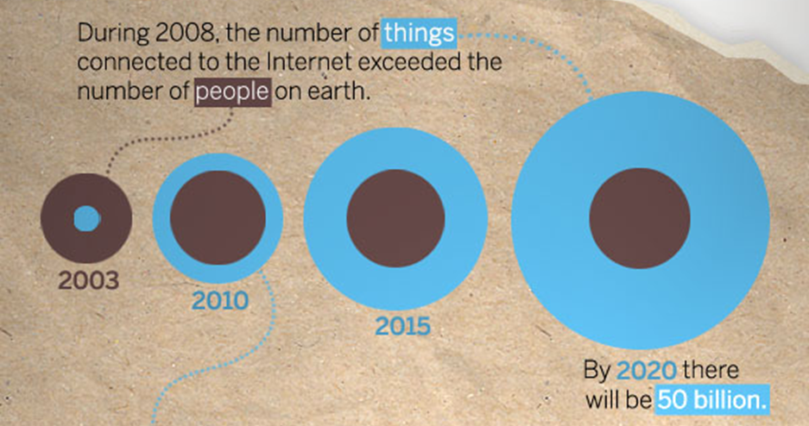
Connected devices will soon be EVERYWHERE
http://blogs.cisco.com/news/the-internet-of-things-infographic/
Notes:
2008: more things than people
2020: 50 billion

Slide 4
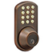
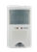
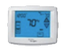



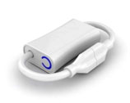
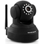
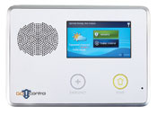
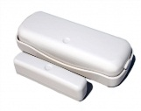
Including your home
Inexpensive
Need “no new wires”
Use regular voltage or batteries
Wireless communication
Use maturing, reliable standards
Z-Wave, ZigBee, Powerline

Slide 5
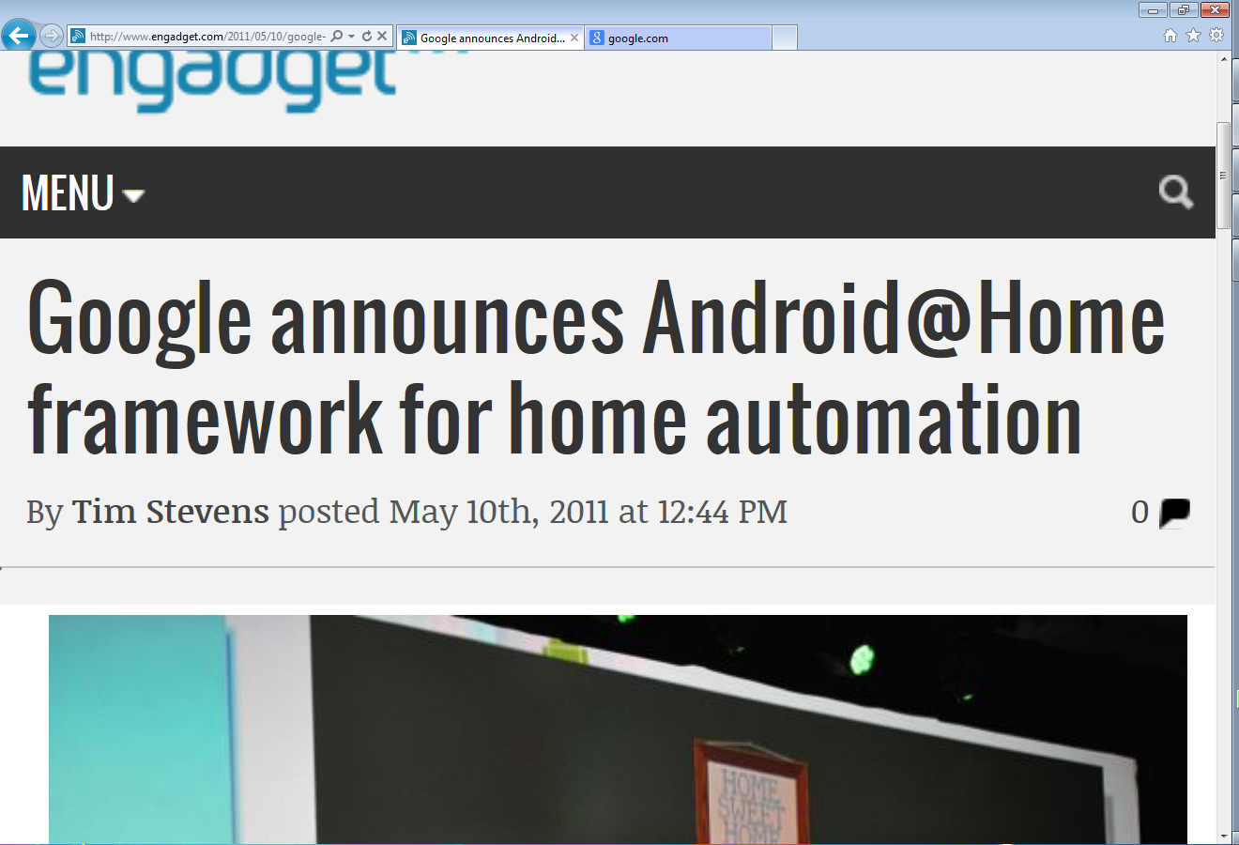
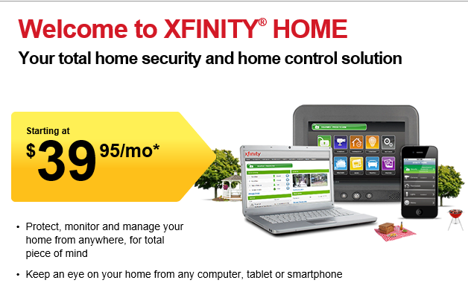
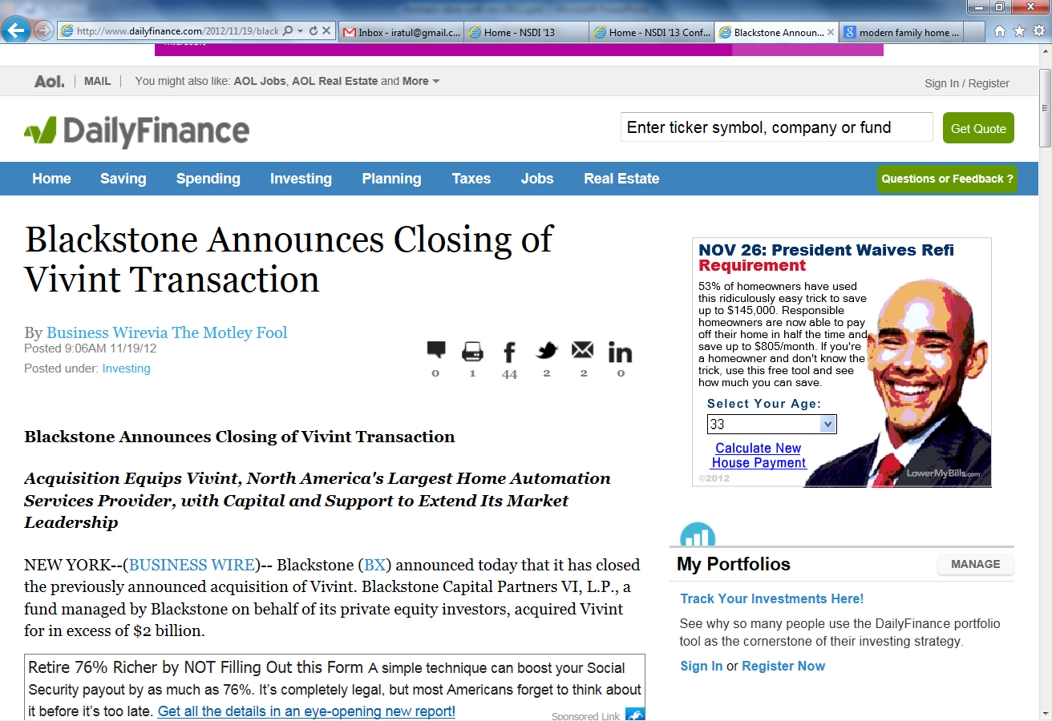
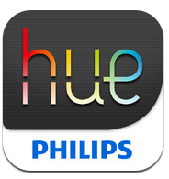
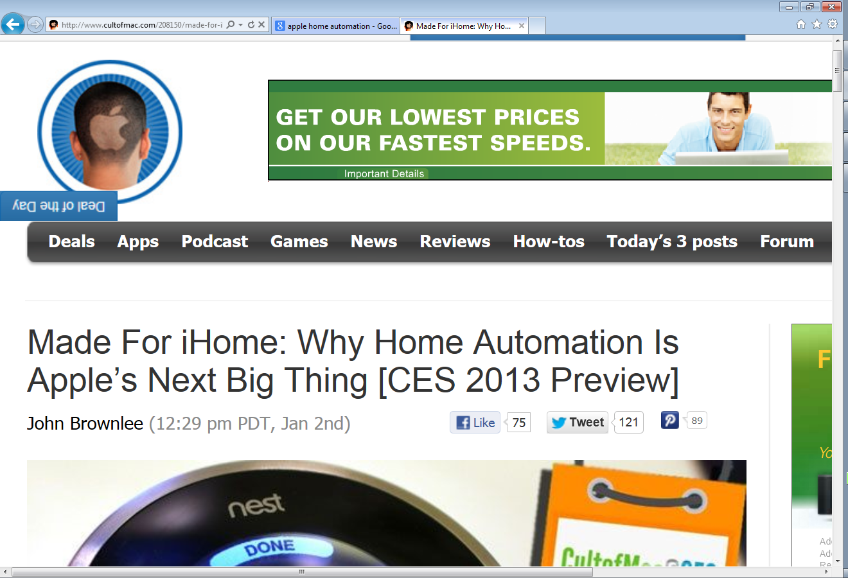
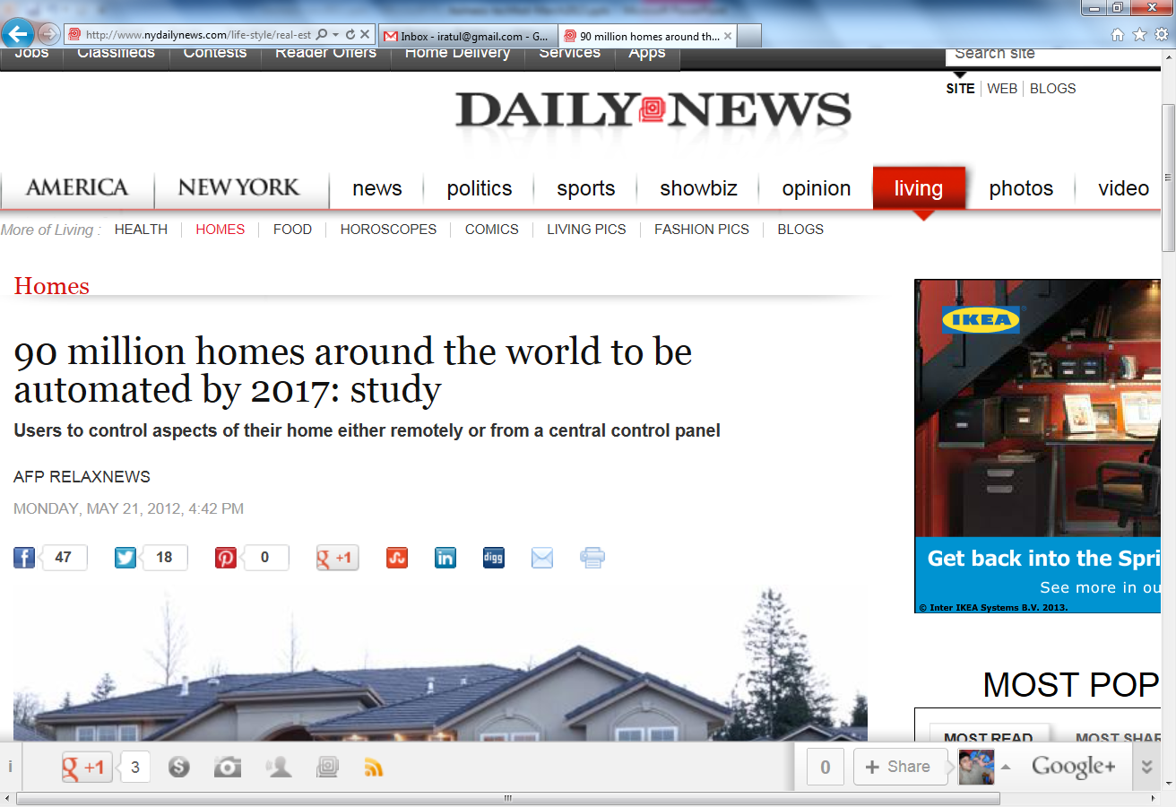
Notes:
A small sampling of headlines over the past year or so …
90M smart homes; market cap of $6 bn.

Slide 6
Opportunity
Notes:
We have a small window of opportunity to get things right:
Security, privacy, manageability, reliability, ….
Much harder after the deployed base becomes huge

Slide 7
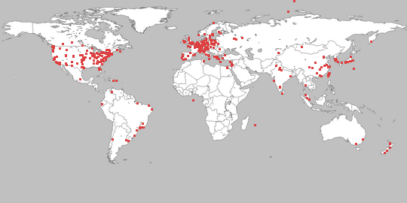
Challenges in conducting experimental work
Prototyping
Managing deployments
Scaling and diversifying
Notes:
1. Devices, software, what works and what doesn’t, custom protocols, etc.
2. Managing studies – updating software, collecting, data, etc.
3. Ability to go beyond a dozen houses in your neighborhood
Overall, the engineering effort is HUGE
I come from a systems/networking background:
- easy to commandeer 100s of machines
- used to mock hci work with 10 homes
- but I am reformed now.
Not many groups have the expertise.
- They shouldn’t need the expertise!
If we have lower the barrier, non-CS folks can also start playing in the domain
- Think of medical experts, energy experts, vision experts, …..

Slide 8
Notes:
This is where LoT comes in!
A flexible platform for experimental research that uses connected devices
Simplifies prototype development: easy interconnection of devices and implementation of application scenarios
Simplifies deployment management through cloud services that monitoring field studies and collect data
Enables easy sharing of data, code, and participants

Slide 9


Slide 10
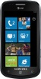

Problems with existing platforms
or
Device integration
Extensibility
Manageability

Slide 11

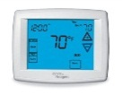

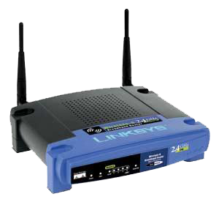

Problems stem from existing abstractions
Network of devices
Interoperability protocols
DLNA, Z-Wave, Speakeasy, …
Open, low-level device access
Appliance
Monolithic systems
Crestron, Control4, …
Fixed tasks over fixed devices
Setup and management is hard
Users must manage each device/task
Developers must deal directly w/ h/w
Extensibility is hard
Closed set of tasks
Closed set of devices
Remote monitoring
Climate control
Notes:
Making extensibility and manageability easy is about finding the right abstractions. So, what are the main abstractions around which home technology is organized today? There are two.
The first abstraction is a network of devices. This viewpoint leads one to develop protocols by which devices can talk to each other, that is, interoperability protocols. It does not worry so much about how tasks are implemented on top of this network.
The second abstraction is of an appliance. This views technology as complete, closed systems. It leads to software that is coupled directly with the hardware and works only with the specific devices: vertical integration.

Slide 12

HomeOS abstraction: view the home as a PC
Networked devices =~ peripherals
Tasks over these devices =~ apps (over high-level APIs)
Managing devices =~ managing files
[The home needs an operating system (and an app store), HotNets 2010]
Notes:
A different paradigm for organizing technology in the home

Slide 13
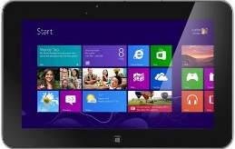
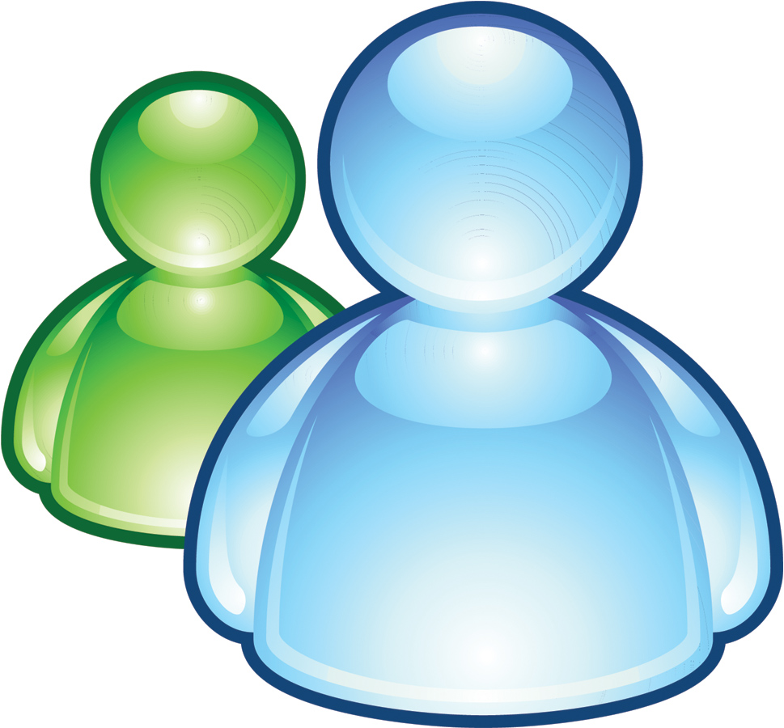
Implementing the abstraction
App UI
Home store
Security
Climate
……..
Home hub
Z-Wave, DLNA, WiFi, etc.
Notes:
1. HomeOS logically centralizes all technology in the home.
2. Cross-device functionality is implemented by applications, not users or devices
3. Users interact with HomeOS rather than individual devices, which makes them easy to manage.
4. HomeOS provides applications simple APIs to access these devices
5. HomeStore simplifies the tasks of finding compatible devices and applications.

Slide 14
Home hub layering model
Apps use high-level abstractions
Simplifies app development
Manifests enable compatibility checks
Application
Mgmt. and access control
Device functionality
Device connectivity
Primitives are specialized to home setting
Simplifies management
Device capabilities are exported as services
Decouples apps and device protocols
Allows for differentiation by vendors
. . . . .
Device discovery, pairing, and comm. for multiple protocols (e.g., DLNA, Z-Wave)
[An operating system for the home, NSDI 2012]
Notes:
Implementing all those scenarios in a tractable manner requires a robust and flexible software architecture.
HomeOS architecture is composed of four layers.

Slide 15
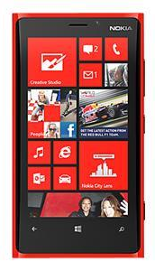

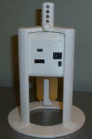
Data logger
Monitor
Updater
Relayer
App UI
Apps
HomeOS
Scouts
Drivers

Slide 16
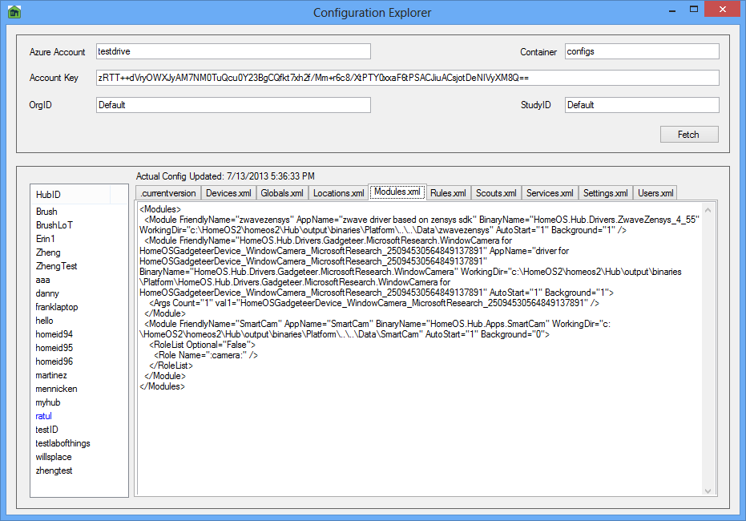
Data logger
Monitor
Updater
Relayer
App UI
Apps
HomeOS
Scouts
Drivers

Slide 17
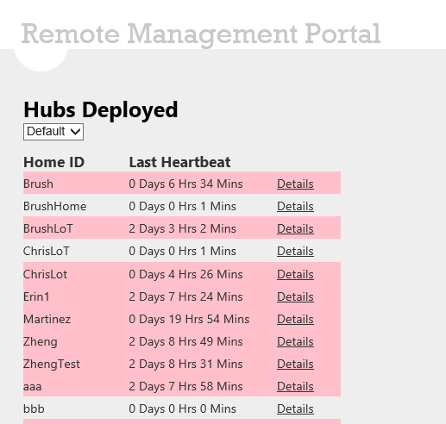
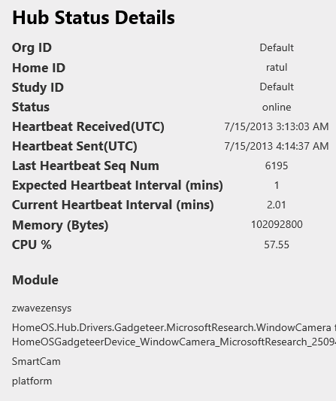
Data logger
Monitor
Updater
Relayer
App UI
Apps
HomeOS
Scouts
Drivers

Slide 18
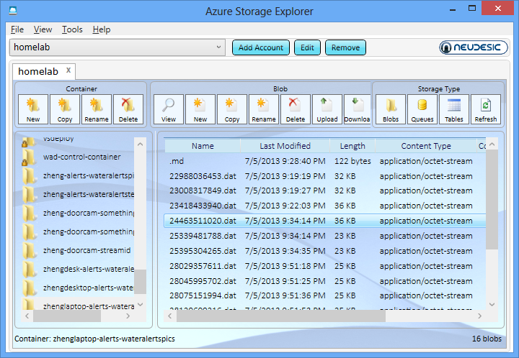
Analysis scripts
Data logger
Monitor
Updater
Relayer
App UI
Apps
HomeOS
Scouts
Drivers

Slide 19
Analysis scripts
Data logger
Monitor
Updater
Relayer
App UI
Apps
HomeOS
Scouts
Drivers

Slide 20

Collaborate to scale and diversify
Share code, data, and participants with fellow researchers
Notes:
PlanetLab: Test of time award!

Slide 21
Demo

Slide 22
Try it today!
Notes:
Use for your research and teaching
Source code available at labofthings.codeplex.com
100+ students have already developed HomeOS apps and drivers

Slide 23
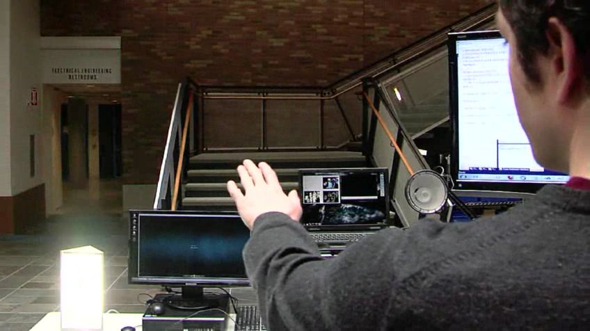
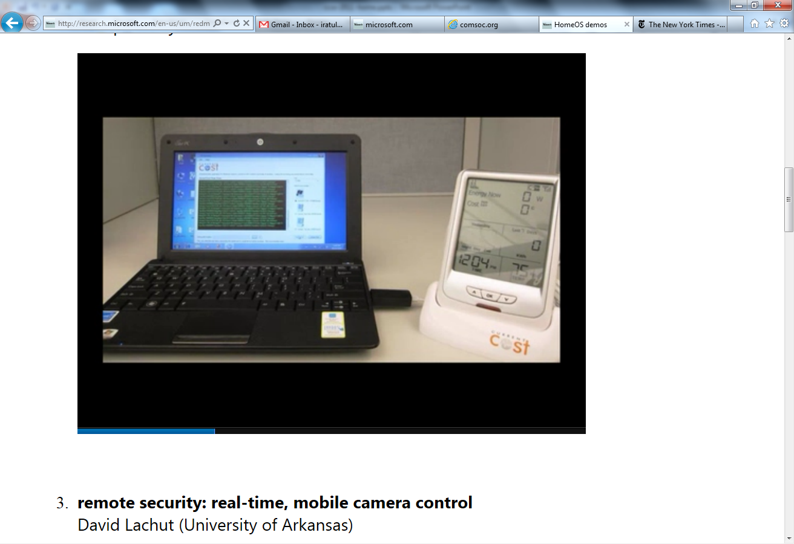
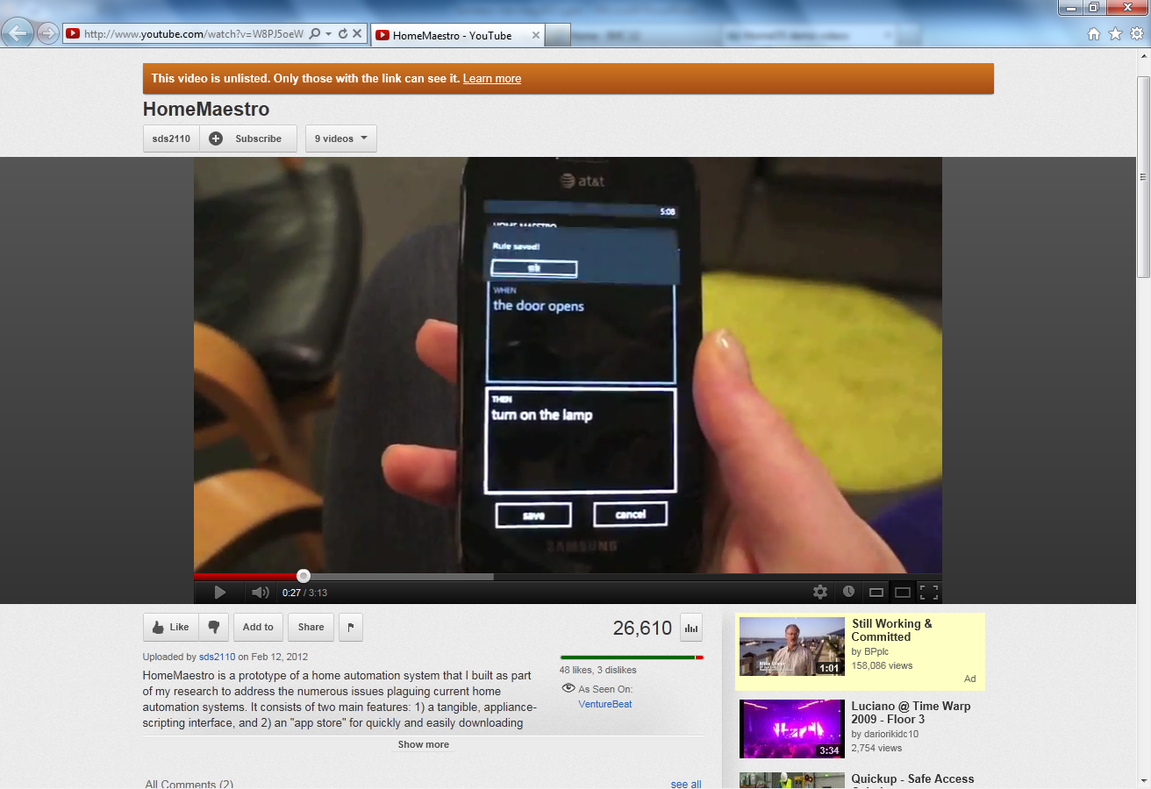
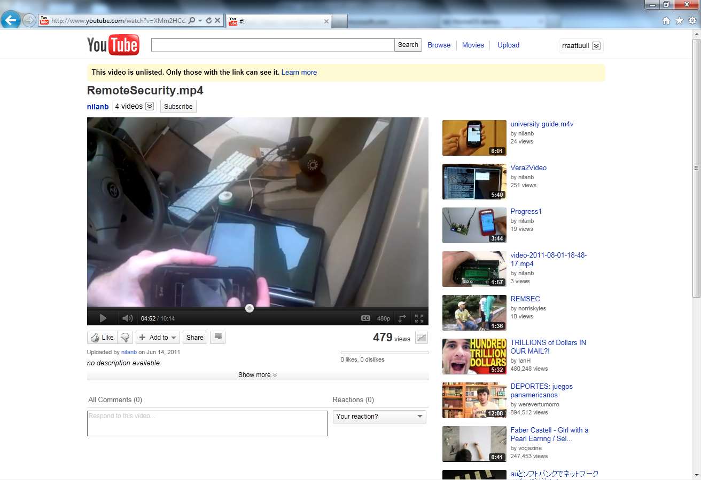
Example “3rd party” applications
For more, see http://research.microsoft.com/homeos/
Notes:
Kinect control, energy monitoring, Remote control of mobile camera, integrated home multimedia management, custom notifications

Slide 24


Management and access control
What primitives are needed in an home app store world?
Time-based access control
Apps as security principals
Easy-to-understand settings
[Home automation in the wild: Challenges and opportunities, CHI 2011]
[An operating system for the home, NSDI 2012]
Notes:
A major imperative in the design of this layer for us was it be configurable by non-technical users.
- Research shows that this requires primitives that are well-aligned with how users want to manage and control technology. Interfaces slapped on after the fact are not as effective. Instead, the design itself should reflect users’ mental models.
We uncover these mental models in interviews of the same set of participants that I mentioned earlier.
- We told them about a HomeOS-like system and asked them how they would like to control and manage it.
I summarize what we learned.
- Of particular note is how the requirements primitives differ from those in current PC OSes.
Time-based access control Our participants wanted to control access to devices based on time. Parents mentioned restricting children from using certain devices after certain times (e.g., “If my daughter wanted watch [Curious] George at 11 o’clock at night, I wouldn’t want to do that”). While social interaction suffices to address some of these concerns, many parents asked for technical means as well. Time-based access control is also needed to give households an ability to grant a variety of access durations for guests (e.g., a few hours to babysitters and a few days to house guests). Current commodity OSes provide coarse-grained parental controls that can limit whole accounts to certain times of the day, but they lack flexible controls that can easily implement policies such as those above.
Applications as security principals Users highlighted a desire to be able to limit applications’ abilities to access devices. One participant said “I don’t want to grant it [the application] access to everything, just my laptop.” A participant in a different home commented about another application: “if it said my DVR and my TV I would say fine, ... if it had my phone or my computer I would want to be able to choose [what it can access].” This observation requires treating applications as first-order security principals, in addition to users. In current PC OSes, users alone are the primary security principals (with some exceptions such as firewall rules in Windows), and applications simply inherit users’ privileges. While smartphone OSes treat applications as security principals, they are solving the simpler problem of regulating single-user, self-contained resources.
Easy-to-understand, queryable settings As expected, users complained about complicated interfaces to configure devices (and especially security), but they also bemoaned the lack of a simple way to verify security settings. They had no way convince themselves that they had correctly configured their settings. For example, to ask if guests can access security devices or if a given application cannot unlock the door after 10 PM. Providing reliable answers to such questions is difficult in current OSes due to issues such as dynamic delegation [10]. In the home, the consequences of incorrect configurations can be severe, requiring even more confidence in security. The lack of such a capability can scare users away from the idea of using new or potentially dangerous capabilities, even if it is possible they are correctly configured. For instance, a participant with electronic door locks said he had not hooked up remote access because he was not “100% certain of its security.
Extra sensitive devices Our users showed heightened sensitivity for the security and use of certain devices (e.g., locks and cameras). They wanted support to ensure accidentally granting access to such devices was difficult.

Slide 25

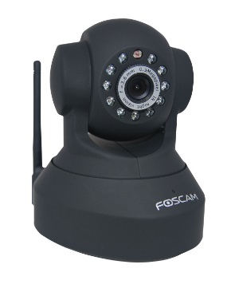
Sensor data sharing
How to enable applications that require data sharing?
Trust is more important than proximity
Reluctance to share field of view
Reason for sharing needed
+
Digital neighborhood watch
[Digital Neighborhood Watch: Investigating the Sharing of Camera Data Amongst Neighbors, CSCW 2013]
Notes:
It is a broad question: decided to use cameras; rich sensor
Motivated by one of our colleagues, we looked at DNW
Providing digital evidence of incidents
Increasing visibility of neighborhood activity
Automatically detecting and alerting for suspicious events
Different attitudes towards law enforcement and commercial entities
Ongoing work: secure matching and deployment

Slide 26
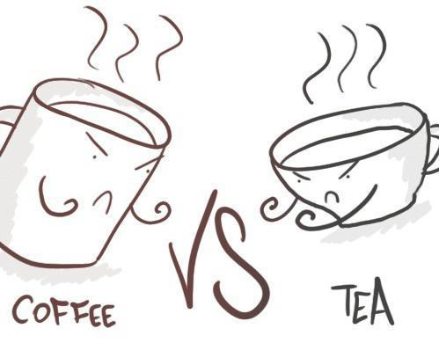


Secure management of device data
How should data from connected devices be stored and accessed?
Time series data
Different preferences
Lack of trust in cloud
Notes:
Time series data
Different preferences
Trust in cloud

Slide 27
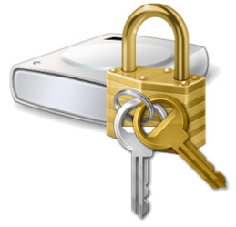

Example open problems
Detecting information leaks
Finer-grained sharing
Secure devices
Notes:
This is just a sampler; I am sure that you can come up with more.
Irrespective of how secure you make the underlying system, unwanted data will leave the home (misconfigurations and bugs)
- webcamera attacks: Access to a woman’s camera female owner is sold at $1 per camera. (but with the same money you can buy access to 100 machines owned by men!)
- firmware bugs:
Develop anomaly detection techniques on information leakage
- akin to intrusion detection but with differences
Brings out the conflict between security and privacy (due to logging).
Currently, we give access to the entire data streams from a device
Indirect inferences make it a risky proposition
- e.g., TV channels from energy data
Can we do better?
- Trusted filters
Devices protocols like z-wave and zigbee have really not been analyzed rigorously for security, as far as I know.
Many of the devices don’t even use basic encryption; I bet I can stand outside your home and muck with your lights
We need security experts to take a close look and develop usable secure mechanisms for such devices
Smartphones and tags present a good opportunity

Slide 28
Summary
Research on connected devices in homes can make a real impact
LoT lowers barrier for experimental work in this domain
Try it today!
lab-of-things.com labofthings.codeplex.com
Notes:
Impact:
- The time is right
- Lots of hard and important problems
Lower barrier:
- Simplifies prototype development
- Simplifies deployment management, - Enables sharing of code, data, and participants

